Slide 1
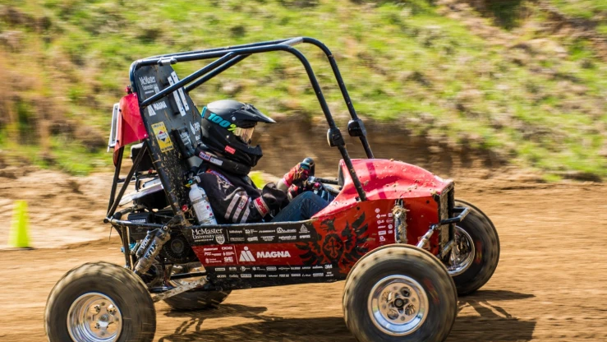

CVT – Simulator
Team 17

Slide 2

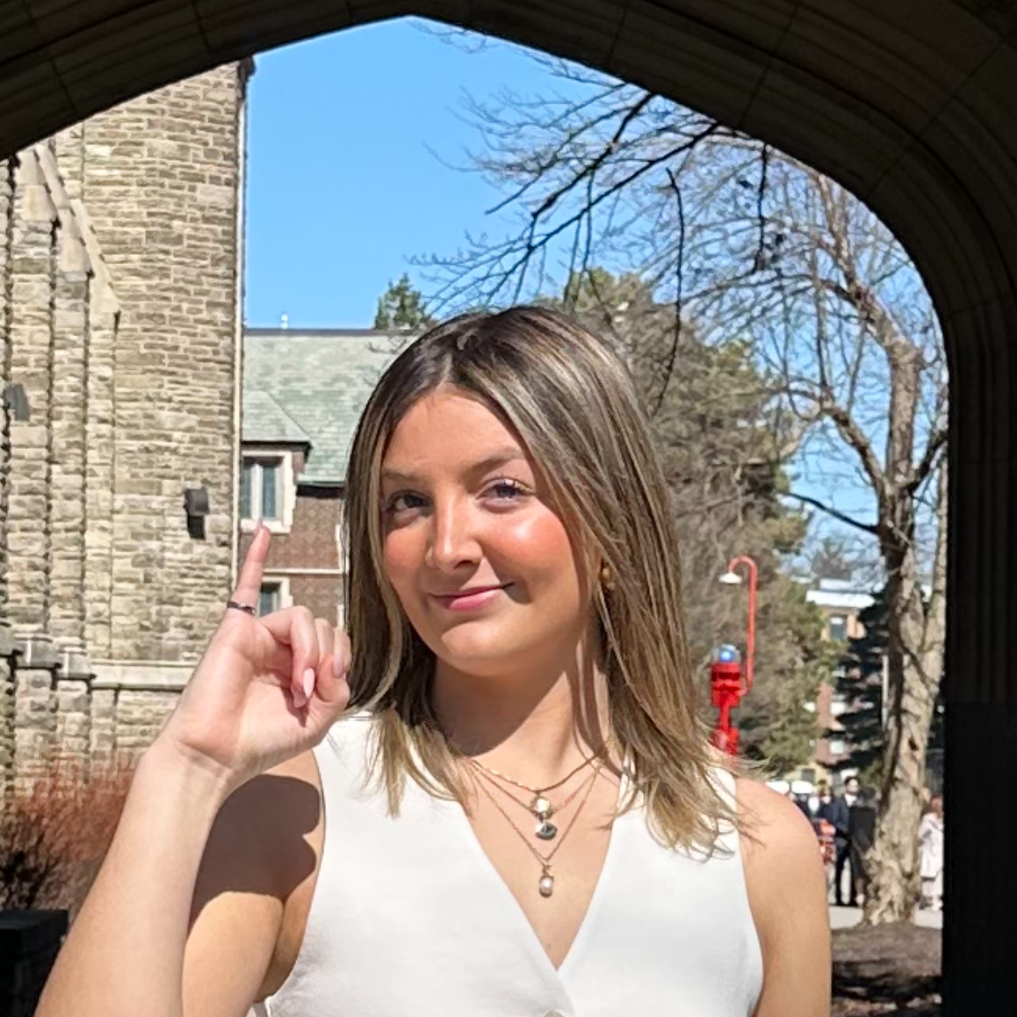
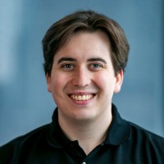
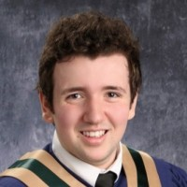

Team Members
Grace McKenna
Travis Wing
Cam Dunn
Kai Arseneau
Our Supervisor: Dr. Spencer Smith

Slide 3
Roadmap
Project overview/problem
Objectives and Features
Key Functional Requirements
Demo
Performance
Future Features and Next Steps

Slide 4
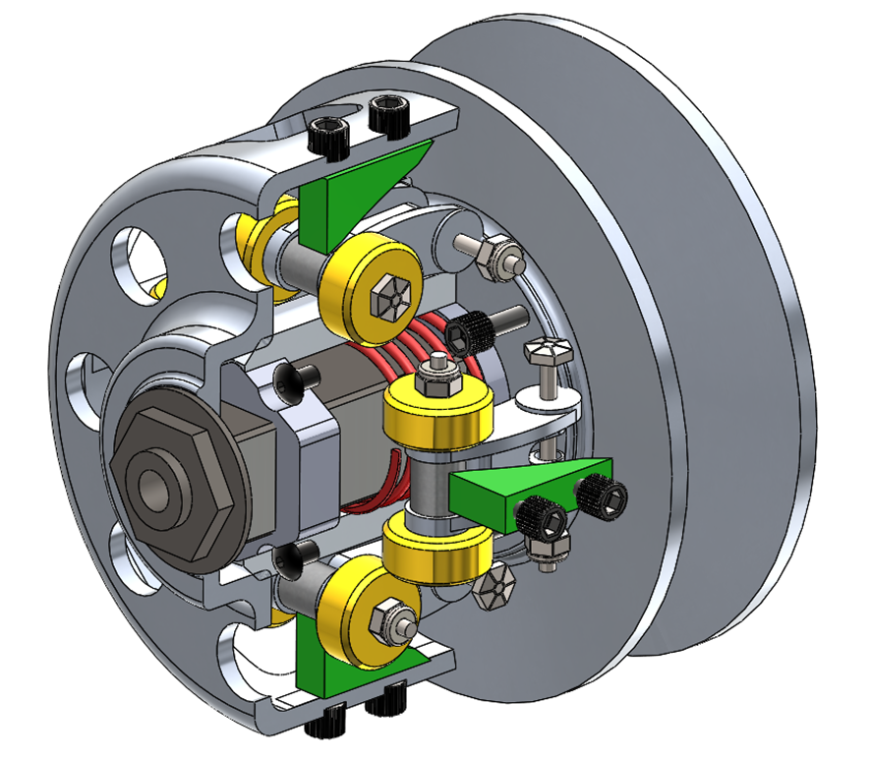
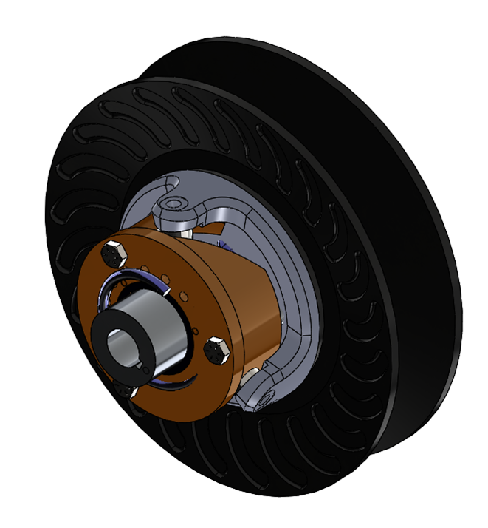
Overview
Current Problem: McMaster Baja currently CVT tuning process is time-consuming and inconsistent due to physical testing.
Our Goal: Develop a simulation tool to virtually tune CVT parameters and test their impact. To thus figure out the optimal tuning parameters and improve vehicle acceleration and hill-climbing performance.
Primary CVT
Secondary CVT

Slide 5
Objectives and Features
Simulate CVT system behaviour using mathematical models
Create a 3D visualization of the CVT system
Enable users to test different tuning parameters
Allow users to playback the simulation
Provide accurate, validated output data for performance analysis
Allow users to save and export data from the software

Slide 6
Key Functional Requirements
Simulation & Core Calculations
R1: Simulate the McMaster Baja Team’s CVT using mathematical models.
R2 – R4: Calculate acceleration, velocity, and distance as a function of time.
R5 – R6: Compute primary and secondary clamping forces based on CVT parameters.
User Input & Interaction
R10 – R12:
Allow users to adjust CVT tuning parameters
Allow input of vehicle/driver weight, traction, and incline
Provide a user interface for data entry
Output & Visualization
R13: Display graphs of simulation results.
R14: Enable export of simulated graphical data.
Accessibility & Compatibility
R15 – R16: Accessible via PC or laptop, compatible with Windows, macOS, and Linux.

Slide 7
Demo

Slide 8
Performance

Slide 9
Next steps and future features
Excluded Wear and Tear (A5): Limits realism for long-term use and component aging. Future fix: consider degradation factors
Full Throttle Only (A7): Doesn’t reflect partial throttle or real driving conditions. Future fix: implement variable throttle input.
No Belt Slippage (A9): Overpredicts torque transfer and grip reliability. Future fix: simulate slippage based on friction.
Forward Motion Only (A11): Cannot simulate braking, reversing, or rollback. Future fix: expand model to include reverse dynamics
Due to these assumptions there are no dynamic loading scenarios: Currently unable to simulate transitions like flat terrain to hill climbs (backshifting), which is something we would like to include in a future revision by removing some assumptions

Slide 10
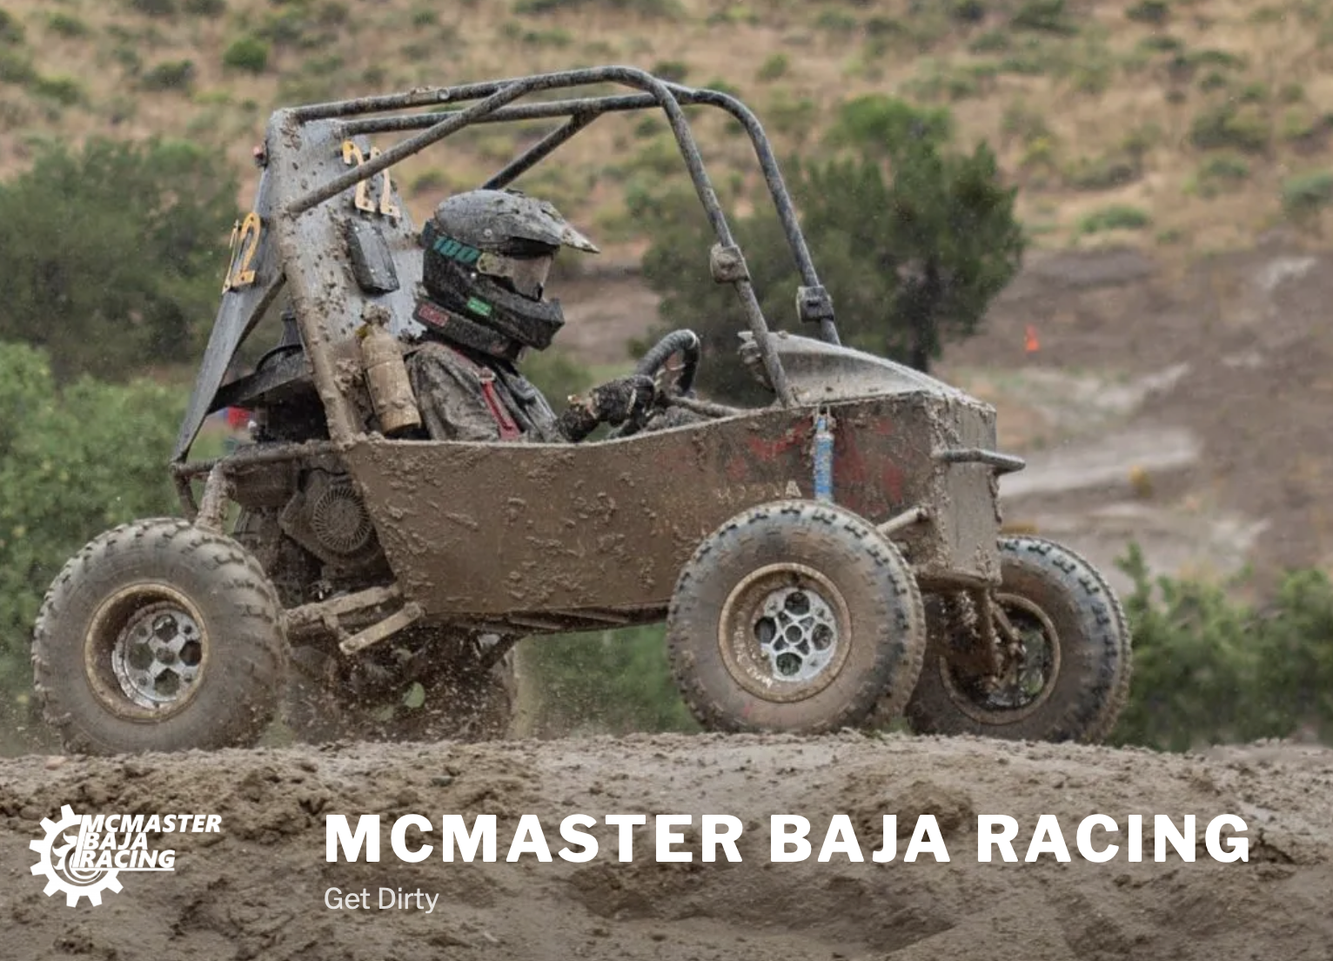
Thanks for Listening!
CVT-Simulator - Team17

